Slide 1
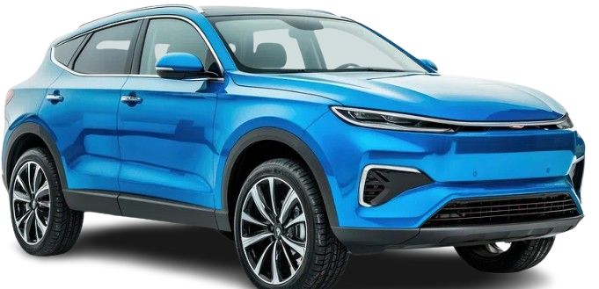

USED CARS PRICE ANALYSIS
- SUMANTH KOTHAKONDA

Slide 2
INTRODUCTION
Website Name : CARS24( CARS24 Services Private Limited )
Industry : Indian Automotive Technology company that operates a Digital-first online marketplace for used vehicles .
Founded : 2015
Headquarters : Gurugram , India .
CARS24’s platform connects individual sellers, buyers, and dealers, enabling seamless transactions that remove many traditional frictions associated with the used-car market such as uncertain pricing, manual paperwork, and fragmented dealer networks. Its core offerings include AI-powered pricing and valuation tools, doorstep vehicle inspection, instant payment solutions, and complete paperwork management all designed to simplify the process for users.
The company has rapidly transformed how used cars are bought, sold, financed,
and managed by integrating technology, transparency, and end-to-end
services across the automotive lifecycle.

Slide 3
PROBLEM STATEMENT
Car price variation based on various cars brands.
Best cars with good quality with less price.

Slide 4
OBJECTIVES
To collect used car listing data from the CARS24 platform through automated web scraping.
To clean and preprocess the data by handling missing values, inconsistencies, and outliers.
To analyze pricing trends and market patterns in the used car ecosystem.
To identify key factors influencing used car prices such as brand, age, mileage, and fuel type.
To derive actionable insights that support data-driven decision making.

Slide 5
METHODOLOGY
Web Scraping
- Scraped all the cities data from CARS24 website .
Data Cleaning & EDA
- Cleaned the raw csv files , added new columns and run the basic EDA using python
SQL Analysis
- Analyzed the data and found the key metrics .
Data Visualization
- created an interactive dashboards / reports using Power BI

Slide 6
WEB SCRAPING
Declared the URL (ex : https://www.cars24.com/buy-used-cars hyderabad/) .
Automated the CARS24 website to get scrolled by using scrolling logic with selenium .
Stored HTML content of the page .
Converted messy HTML into well formatted and human readable structure using prettify( ) .
Created empty lists of required columns .
Stored the data in empty lists .
Converted the data into DataFrame .
Saved the file

Slide 7
DATA CLEANING & EDA
Checked for nulls (No null values present)
Checked for duplicates (No Duplicates present)
Standardized the Column names .
Standardized the Data .
Declared current year and creating a new column car_age_years
car_age_years = current year – manufacturing year
Added a new column ‘ city ‘ .
Outliers Detection .
Final Validation .
Saved the file .

Slide 8
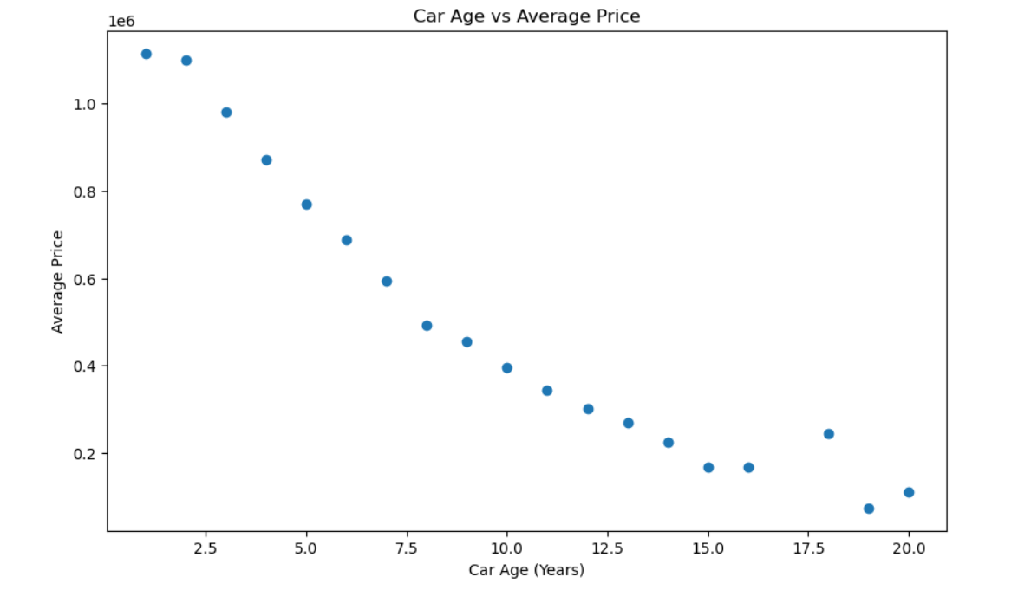
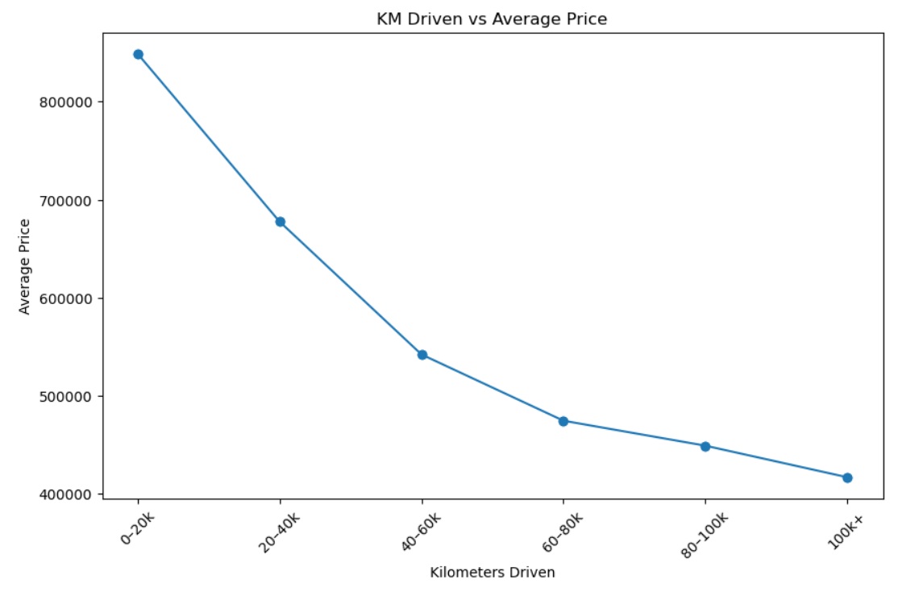
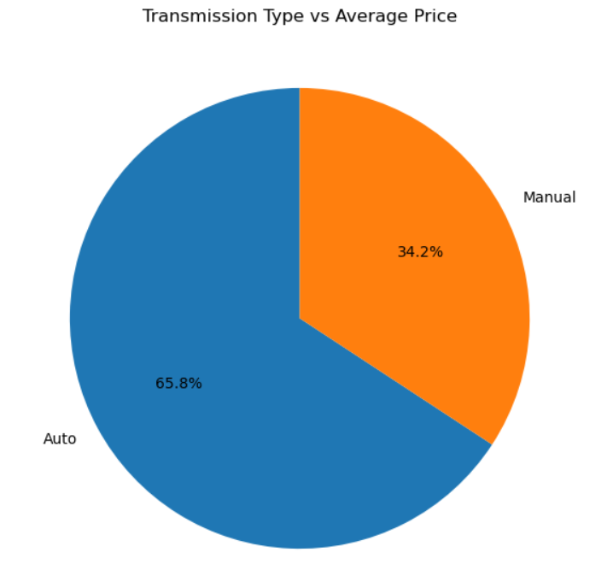
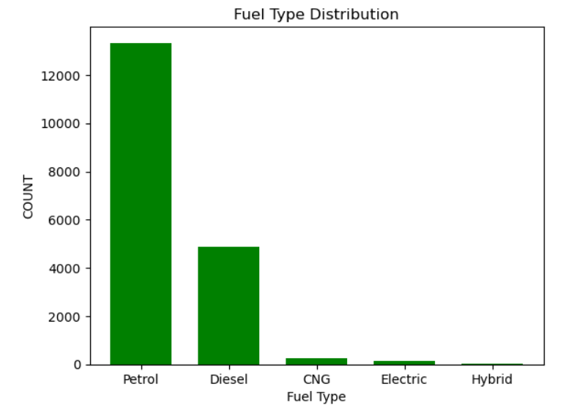

Slide 9







SQL ANALYSIS
Loaded the Data .
Performed some of the Basic Analysis
Calculated Derived metrics such as Total Cars , Total Brands , Highest Price ,
Lowest Price , Avg Price , Newest Model Year , Oldest Model Year .

Slide 10
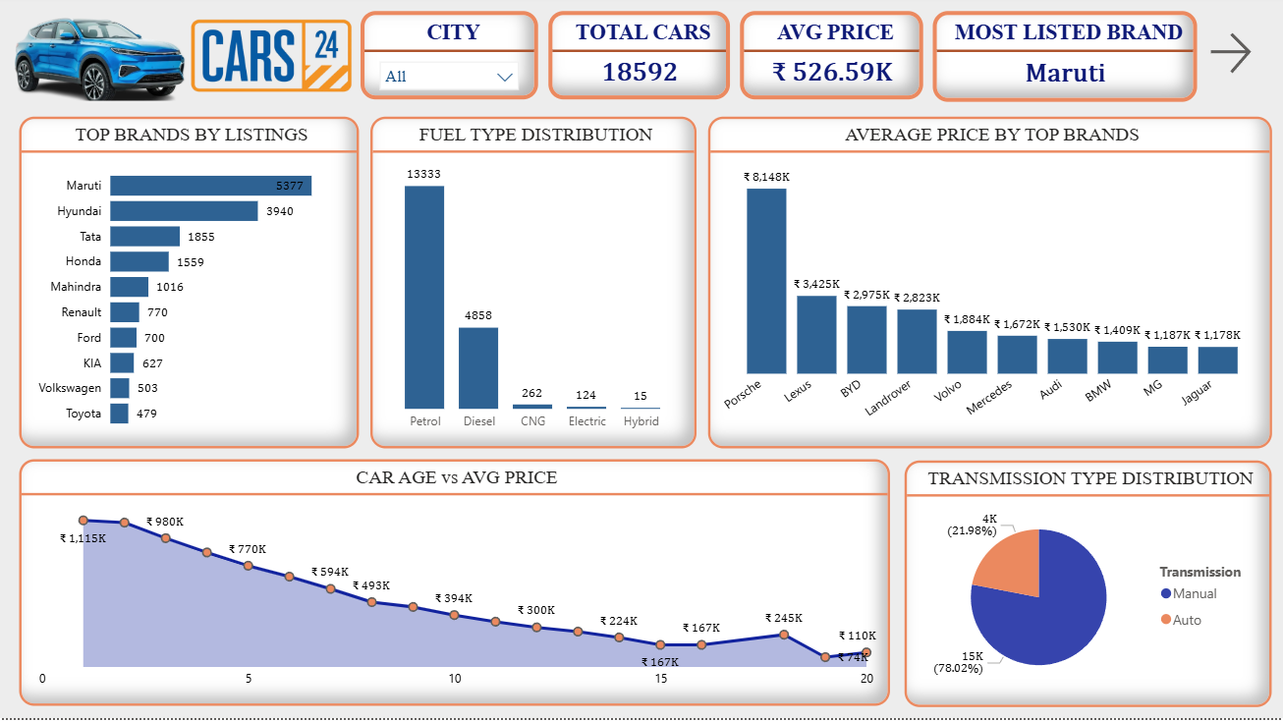

Slide 11
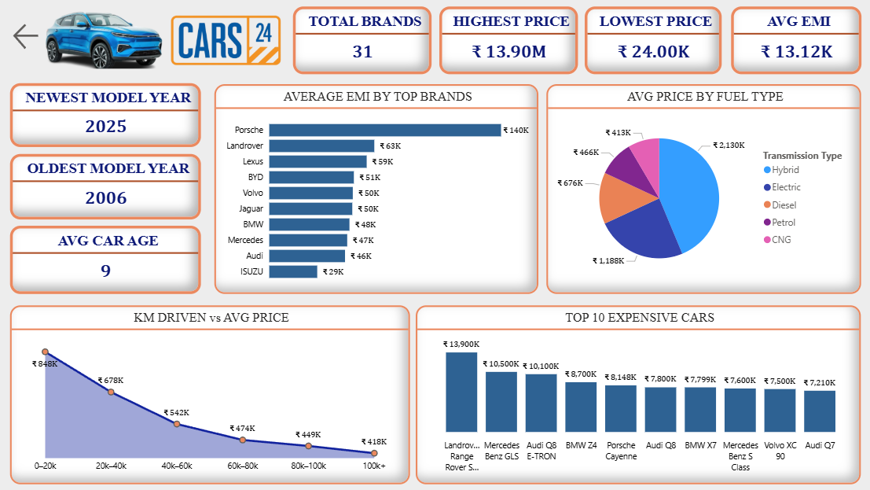

Slide 12
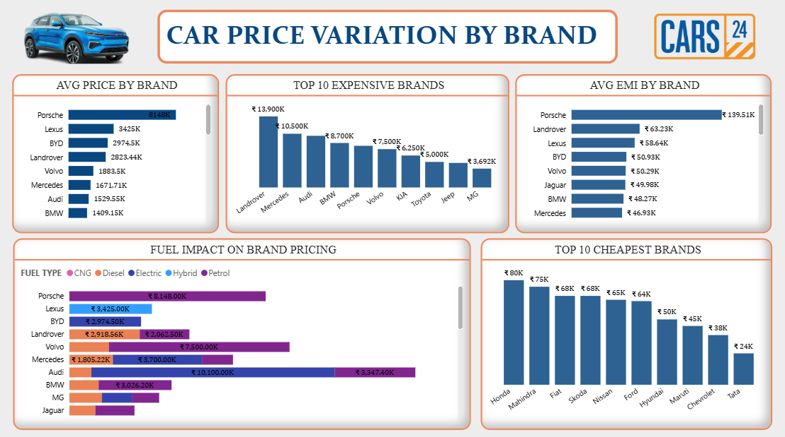

Slide 13
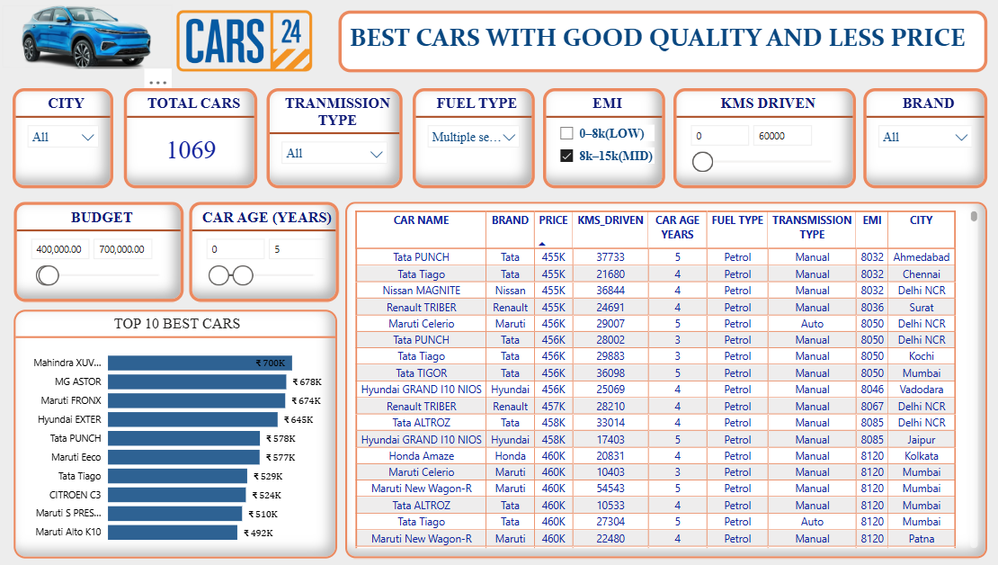

Slide 14
KEY FINDINGS
There are 18592 cars with 31 unique brands listed .
Most listed brand is ‘ Maruti ‘ .
Expensive brands has more EMI than budget brands due to their price difference
Landrover Range Rover Sport is the most expensive car with a price of 1.39 Cr and Tata Nano is the most cheapest car with 24k .
There are more cars with Manual Transmission than Automated Transmission .
As the car age and kms driven is increasing price is getting dropped .
Average price is 526.59k.
Highest price is 13.9M and Lowest price is 24k .

Slide 15
KEY INSIGHTS
Car price is strongly influenced by vehicle age and kilometers driven .
Brand reputation plays a major role in price retention .
Automatic transmission cars are priced higher compared to manual cars, reflecting increasing urban demand.
Outliers in pricing are often linked to luxury brands, very low mileage, or
rare model variants.

Slide 16
CHALLENGES FACED
Dynamic website structure made data extraction challenging due to JavaScript-rendered content and frequent DOM changes.
Anti-scraping mechanisms such as rate limiting and dynamic class names increased the complexity of reliable data collection.
Duplicate listings across cities or reposted vehicles needed careful identification and removal.
Outliers and extreme values in price and mileage distorted analysis and required domain-based filtering.
Time-consuming scraping process due to pagination, infinite scrolling,
and delays to avoid blocking.

Slide 17
CONCLUSION
This project successfully demonstrated an end-to-end data analytics workflow by scraping, cleaning, and analyzing used car data from the CARS24 platform.
Through systematic data preprocessing and exploratory data analysis, key factors influencing used car prices—such as vehicle age, brand, fuel type, transmission type , emi , km driven, and city—were identified.
The analysis revealed noticeable pricing variations among cars due its brand value , vehicle age and also distance driven .
Overall, the project provided meaningful insights into the used car market while showcasing practical skills in web scraping, data cleaning, data analysis, and visualization.
These insights can support informed decision-making for buyers, sellers,
and automotive marketplace stakeholders.

Slide 18
THANK YOU

